Slide 1

Working with data in Python

Slide 2
Objectives
Read text files using Python libraries.
Write and save files in Python.
Explain how Pandas use data frames.
Use Pandas for library and data.
Working with data in Python

Slide 3
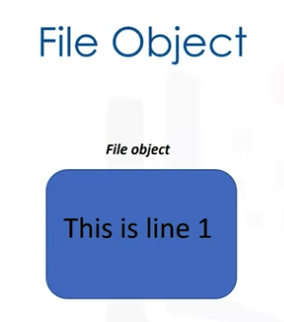
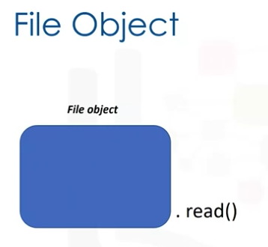
Reading files with open
we will use Python's built-in open function to create a file object, and obtain the data from a "txt" file.
We will use Python's open function to get a file object.
We can apply a method to that object to read data from the file.
Working with data in Python

Slide 4

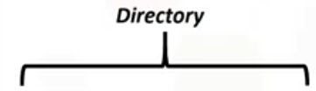


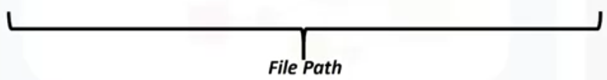

Reading files with open
We can open the file, Example1.txt, as follows.
The first argument is the file path.
This is made up of the file name, and the file directory.
The second parameter is the mode. Common values used include 'r' for reading, 'w' for writing, and 'a' for appending. We will use 'r' for reading.
Finally, we have the file object.
Working with data in Python

Slide 5
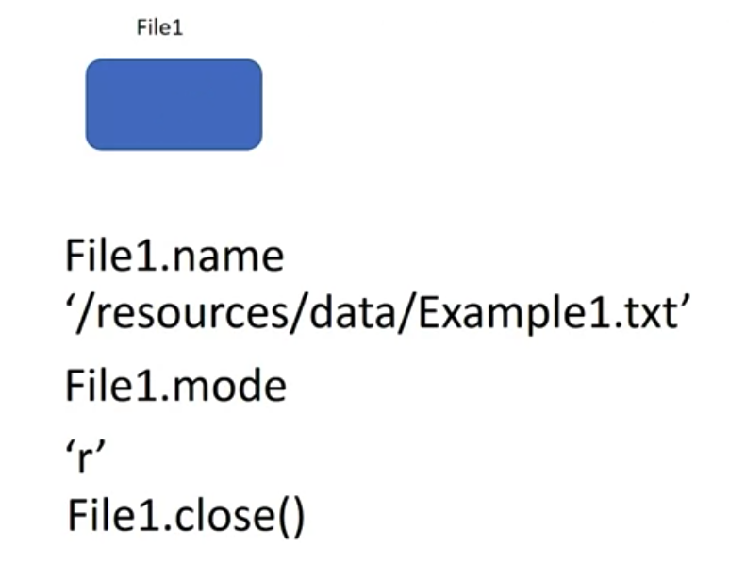
Reading files with open
We can use the data attribute name to get the name of the file: the name of the file
We can see what mode the object is in using the data attribute mode, and 'r' is shown representing read
You should always close the file object using the method close.
Working with data in Python

Slide 6
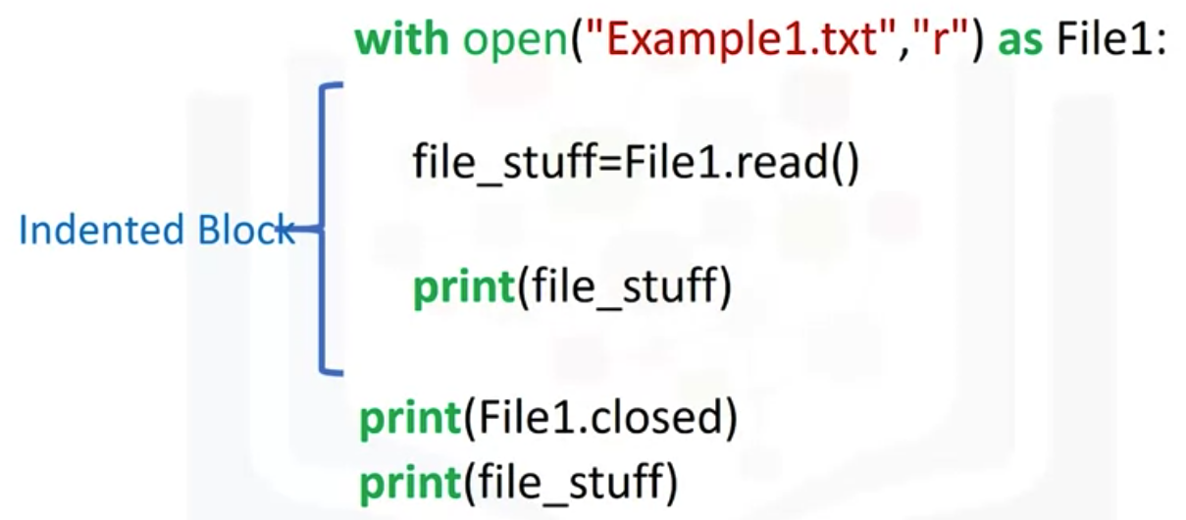
Reading files with “with"
Using a "with" statement to open a file is better practice because it automatically closes the file.
It automatically closes the file object
Working with data in Python

Slide 7
Writing files
We use the open function.
The first argument is the file path. This is made up of the file name. If you have that file in your directory, it will be overwritten, and the file directory.
We set the mode parameter to W for writing.
Finally, we have the file object.
Working with data in Python

Slide 8
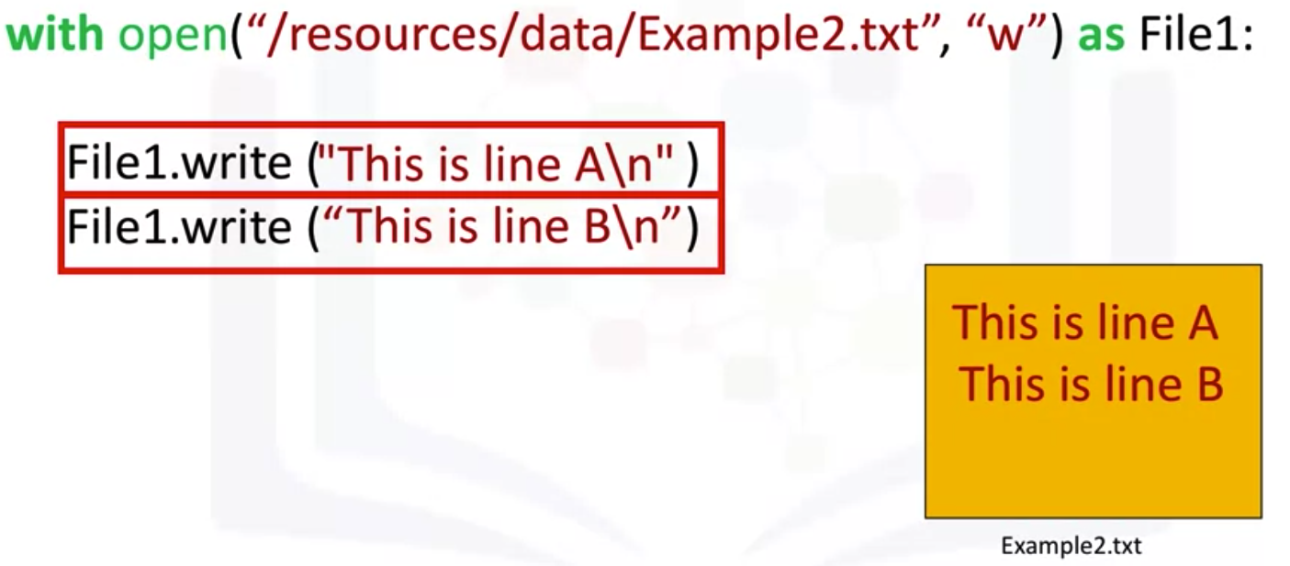
Writing files
Example
Working with data in Python

Slide 9
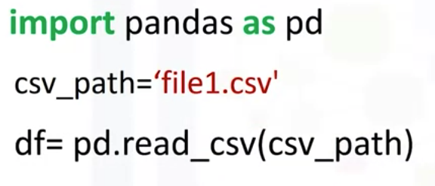
Pandas
It is a popular library for data analysis.
We can import the library: access to a large number of pre-built classes and functions
Example load a CSV file using the Pandas built-in function, read csv.
Working with data in Python

Slide 10
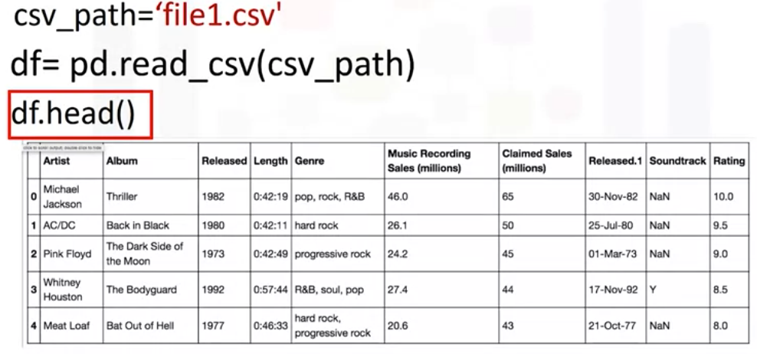
Pandas
One way Pandas allows you to work with data is with the data frame.
We can use the method head to examine the first five rows of a data frame.
Working with data in Python

Slide 11
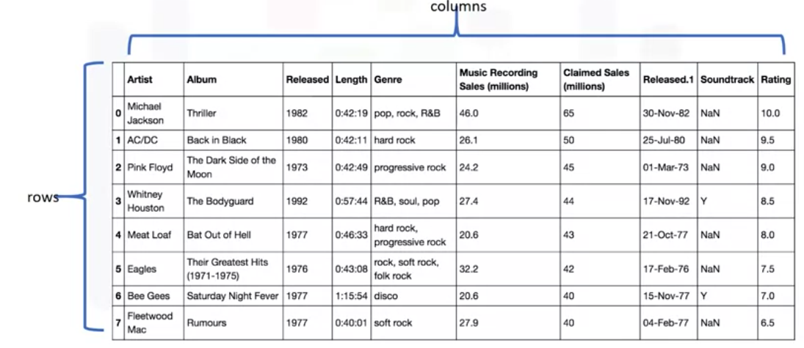
Pandas
A data frame is comprised of rows and columns.
Working with data in Python

Slide 12
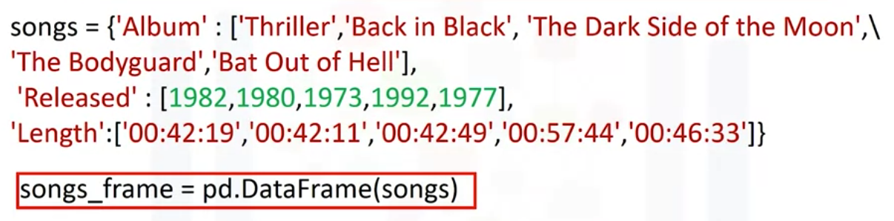
Pandas
We can create a data frame out of a dictionary.
  The keys correspond to the column labels.
  The values or lists corresponding to the rows.
We then cast the dictionary to a data frame using the function data frame
Working with data in Python

Slide 13
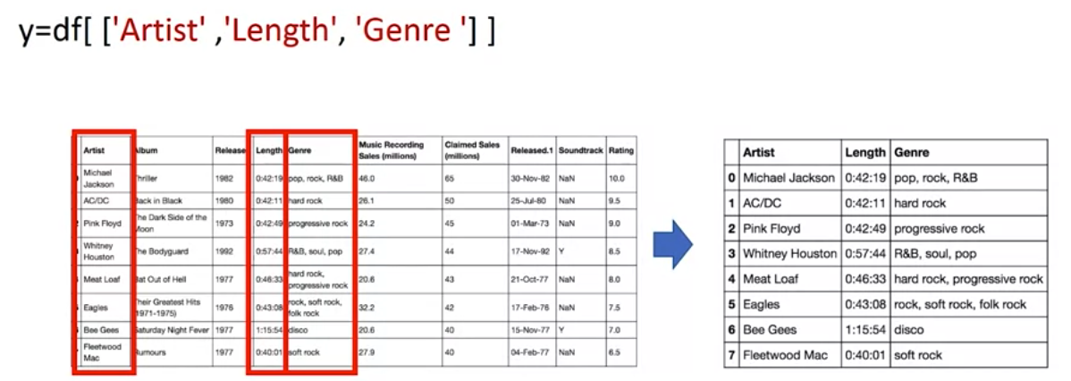
Pandas
We can create a new data frame consisting of one column.
We just put the data frame name, in this case, df, and the name of the column header enclosed in double brackets.
The result is a new data frame comprised of the original column.
Working with data in Python

Slide 14
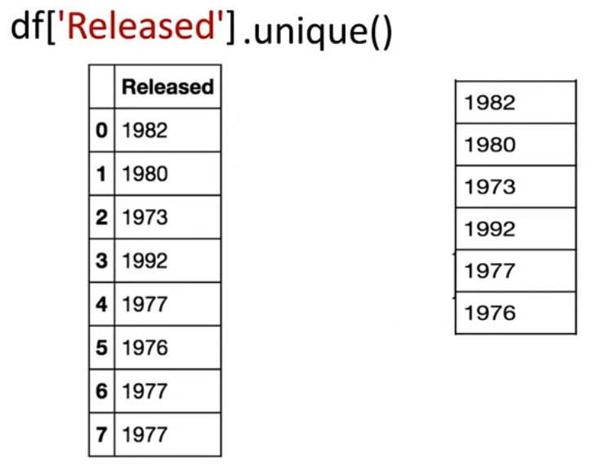
Pandas methods
List unique values
Working with data in Python

Slide 15
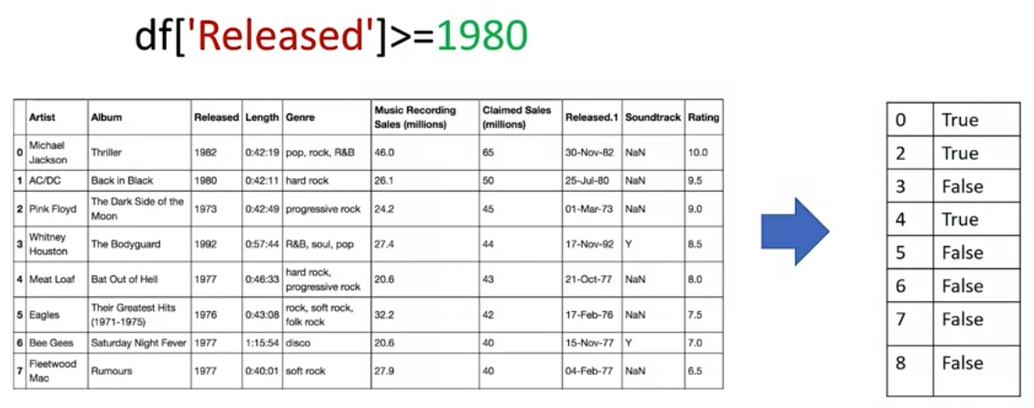
Pandas
The result is a series of Boolean values
Working with data in Python

Slide 16

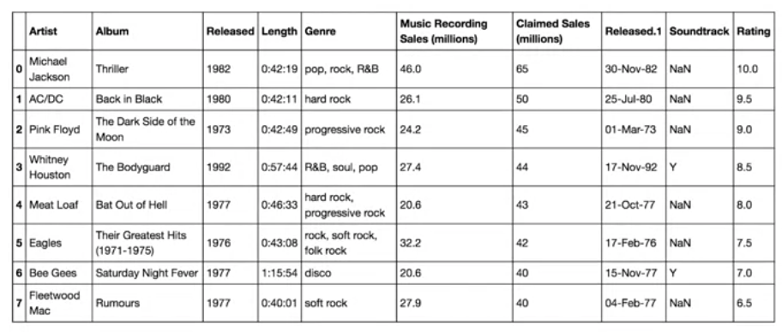
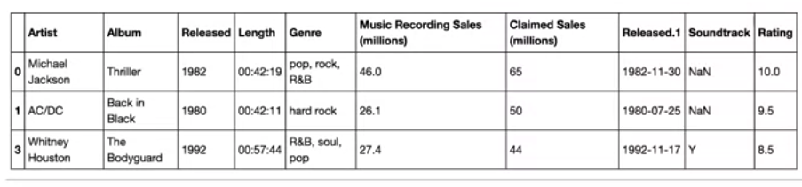

Pandas
We can select the specified columns in one line.
Working with data in Python

Slide 17
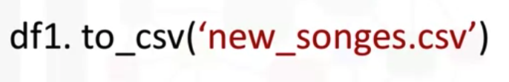
Pandas
Save the data frame in other formats.
Save as CSV
Working with data in Python

Slide 18
Summary
Understand how to read text files using Python libraries.
Understand how to write and save files in Python.
Explain how Pandas use data frames.
Use Pandas for library and data.
Working with data in Python

Slide 19
Q & A
Working with data in Python

